Slide 1

the
workshop

Slide 2
GRAPH WRITING
Paragraph 1: Introduction_paraphrase the question.
Paragraph 2: Write the overview. (no data)
Paragraph 3+4: Describe the graph in detail. (with data)
Paragraphing notes:
1-line spacing between every 2 paragraphs.
Full stop at every paragraph’s end.
No 1st line indentation.

Slide 3
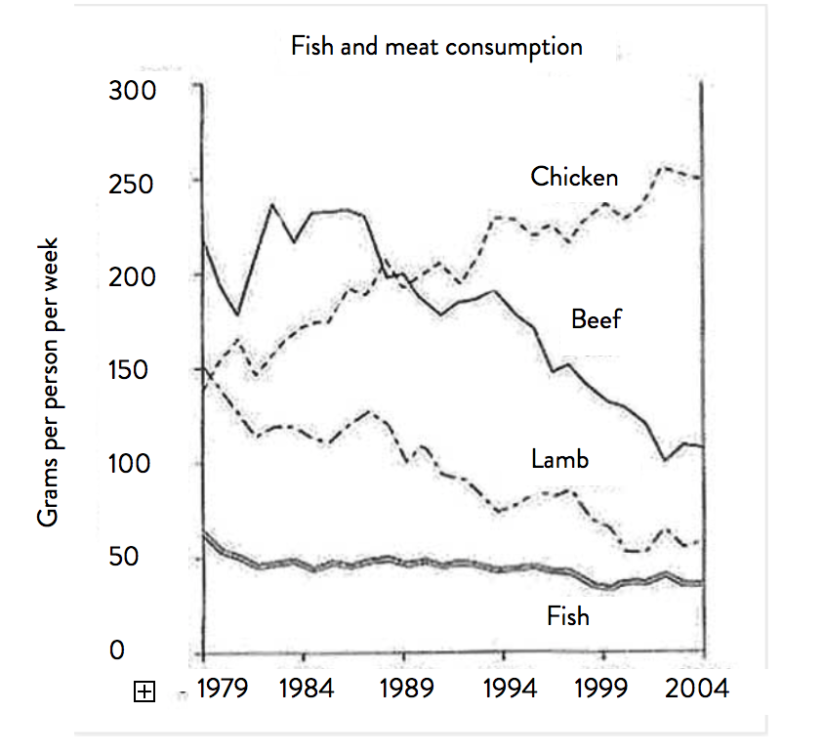
Question: “The graph below shows the consumption of fish and some different kinds of meat in a European country between 1979 and 2004”
Summarize the information by selecting and reporting the main features, and make comparisons where relevant.

Slide 4
PARAGRAPH 1: INTRODUCTION
Step 1: Paraphrase the following sentence (3 ways):
“The graph below shows the consumption of fish and some different kinds of meat in a European country between 1979 and 2004”
The graph = the given chart/line graph (no “following”/“below”/“this”).
Watch out: the number of graphs (the graph illustrates – the graphs illustrate)
Show = illustrate/depict/provide data/information on-about/compare.
Watch out: verb tense
Between 1979 and 2004 = from 1979 to 2004 = over a 25-year period beginning from 1979 = over a course of 25 years starting from 1979.
(MUST PARAPHRASE => score)
The consumption of … = (GRA) the amount of … which were eaten.
(VOCAB) the intake of … (reference only)
Kinds of meat = (VOCAB) meat products vs types/categories (ref only).
Country = nation in Europe (reference only).

Slide 5
PARAGRAPH 1: INTRODUCTION
Step 1: Paraphrase the following sentence:
“The graph below shows the consumption of fish and some different kinds of meat in a European country between 1979 and 2004”
The given line graph illustrates the amount of fish and three other meat categories (which were) consumed in a European nation over a 25-year period (which begins) beginning from 1979.
=> Specify (how many categories, measurements)
=> What graphs depict – present simple

Slide 6
Paraphrase practice
consumer spending on five different products
= consumer budget (for) | the spending patterns (of)
= five different items | commodities
The amount of money which consumers spent on five items (GRA)
The spending patterns of five different commodities (VOCAB)
car ownership in Britain from 1971 to 2007
The number of cars owned in Britain over a period of 36 years… (GRA)
changes in the cost of renting a home between 2009 and 2019
How the cost of renting a home shifted between 2009 and 2019 (GRA)
Shifts in house rentals over a 10-year period… (VOCAB)
Notes:
The number of cars (which were) owned in Britain …
Vì nếu tách ra: the number of cars was owned => sai vì the number of không “owned” được

Slide 7
Step 2: Understanding the graph
Look at the graph and answer the following questions:
1. What information does each axis show?
2. What do the four lines represent?
3. What tense do you need to use to describe this information?
4. What main features does the graph illustrate?
Consumption’s change (TREND – năm đầu và năm cuối)
Most vs least commonly- consumed product. (ORDER – cao nhất/thấp nhất)
Notes:
Dynamic - Tập trung vào 2 thứ: trend và order (trend bài này là gì; order là gì?)

Slide 8
Exercise 2: Ways to describe the order by comparison
“(1979) Consumers ate 200 grams of beef, 150 grams of chicken, 150 grams of lamb and 50 grams of fish per week”
1. So sánh nhất (Most-least)
***Beef’s consumption was the highest. vs the lowest (number).
***Beef registered the highest consumption [registered + ranking].
Beef was eaten most; fish was consumed least.(adv-no “the”).
Beef was the most commonly-consumed meat category. (the adj+n).
2. So sánh hơn (More-less)
(no data): Beef was eaten more than fish.
The consumption of beef was higher than that of fish.
(with data): Beef was consumed 150 grams more than fish.
Beef was consumed four times more than/as much as fish.
So sánh nhất với fish.
So sánh hơn – beef vs chicken & lamb.
Notes:
Fish registered the lowest …
Beef was eaten 50 grams more than / the consumption of was ... Higher than that for/the number for … those for….

Slide 9
PARAGRAPH 2
“Reporting the main features, and make comparisons”
Step 3: write the overview
Comment on trend + (order).
As can be seen from the chart, there was a downward trend in the figures for beef and lamb, while the amount of chicken (which was) eaten experienced a significant growth. In addition, fish was the least commonly-consumed product over the timescale.
Câu 1: Trend (1-2 trend nổi bật)
Câu 2: Order (loại cao nhất/thấp nhất)
Note: overview nên không report data
Notes:
How to use: “the number for”
***Phân biệt với: “the number of”
The number of + N(plural): có bao nhiêu cái gì.
e.g: the number of chickens
- The number/figure/data/statistics for + tên loại / N (ít): số liệu (data) của loại là bao nhiêu
e.g: the amount of chicken consumed was … = the number FOR chicken was …

Slide 10
PARAGRAPH 3
Step 3: describe the graph in details
Body 1: describe beef & lamb’s data.
Looking at the details, in 1979, beef was eaten most, at well over 200 grams a week. This figure was over 50 grams more than those for chicken and lamb and was nearly four times as much as the recorded data for fish. 5 years later, beef consumption grew slightly before it registered a striking decline to 100 grams at the end of the period. The data for lamb, similarly, dropped by a half from 150 to 75 in 2004.
Câu 1&2: Static sentence – 1st year (1979)
(1) loại cao nhất: beef – over 250 grams
Lamb – 150 grams
(2) so sánh hơn: beef vs lamb (1979)
Câu 3&4: Describe trend của từng loại
(4 vital structures)
Notes:
Cho viết 2 câu trend bthg trc - upgrade

Slide 11
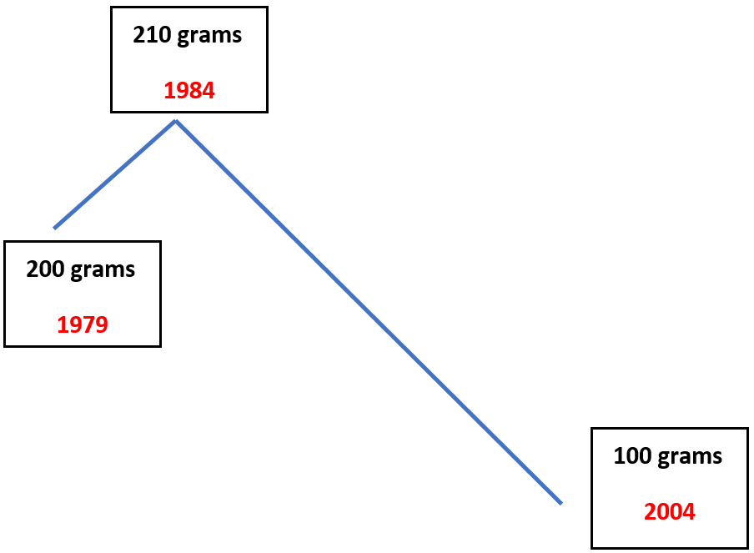
Tả trend | cấu trúc 3 điểm
S + V before + V-ing | S V
, and/but then S V
After…, …
e.g: Between 1979 and 2004, beef consumption grew slightly before declining sharply to 100 grams at the end of the period.
S + V [time] when S V
, at which point S V
e.g: beef consumption grew slightly until 1984 when it declined, and then hit a low of 100 grams …
Beef
Notes:
Cho viết 2 câu trend bthg trc - upgrade

Slide 12
PARAGRAPH 3
Step 3: describe the graph in details
Body 1: describe beef & lamb’s data.
Looking at the details, in 1979, beef was eaten most, at well over 200 grams a week. This figure was over 50 grams more than those for chicken and lamb and was nearly four times as much as the recorded data for fish. 5 years later, beef consumption grew slightly before it registered a striking decline to 100 grams at the end of the period. The data for lamb, similarly, dropped by a half from 150 to 75 in 2004.
Câu 1&2: Static sentence – 1st year (1979)
(1) loại cao nhất: beef – over 250 grams
Lamb – 150 grams
(2) so sánh hơn: beef vs lamb (1979)
Câu 3&4: Describe trend của từng loại
(4 vital structures)
Notes:
Cho viết 2 câu trend bthg trc - upgrade

Slide 13
Từ nối – cohesive devices
2 MAIN TYPES
Nối 2 câu: A + V1. [từ nối], B + V2.
A increased. ______________________________________ , B increased.
A increased. ______________________________________ , B increased.
A increased. ______________________________________ , B fluctuated.
Nối 2 mệnh đề: A + V1, [từ nối], B + V2.
A increased, ______________________________________ B decreased.
A increased, ______________________________________ A decreased.
[cấu trúc trend 3 điểm]
Similarly/Likewise/Having a similar pattern
In contrast/On the other hand/Having an opposite trend
Meanwhile/Having a different progression
while/whereas
before/, and then/ , but then, etc
Notes:
Cho viết 2 câu trend bthg trc - upgrade

Slide 14
PARAGRAPH 4
Step 3: describe the graph in detail
Body 2: describe chicken & fish’s data.
On the other hand, chicken became the dominant meat type. Its figure overtook beef’s in 1989 before jumping to over 250 grams per week in the final year. Meanwhile, the years after 1979 saw no marked change in fish’s data.
Câu 1: Nhận xét chung
(một sự thay đổi ngược lại có thể thấy ở)
Quite an similar/different/ opposite pattern can be seen in A’s data
Câu 2: Describe trend của các loại còn lại
(4 vital structures) + cohesive devices
Notes:
Dấu chấm phẩy – 2 câu nói cùng về 1 thứ
Phẩy khi which registered a boom overtook…
Highlight: overtake kp surpass
Witnessed in – nếu là by thì p là experienced

Slide 15
Intro: paraphrase đề (grammar/vocab)
Overview: (line graph – dynamic chart)
Câu 1: Trend (1-2 trend nổi bật)
Câu 2: Order (loại cao nhất/thấp nhất)
Note: overview nên không report data
Body 1: (nhóm các loại có trend giống nhau)
Câu 1: Static sentence (no change) – 1st year
(loại cao nhất/thấp nhất)
Câu 2: So sánh cùng thời điểm – loại khác
(cấu trúc so sánh hơn)
Câu 3-4: Describe changes/trend của các loại
(4 vital structures)
Body 2: (các loại còn lại)
Câu 1: Nhận xét chung
(một sự thay đổi ngược lại có thể thấy ở)
Quite an opposite pattern can be seen in A’s data
Câu 2: Describe changes/trend của các loại còn lại
(4 vital structures)
SUMMARY

Slide 16
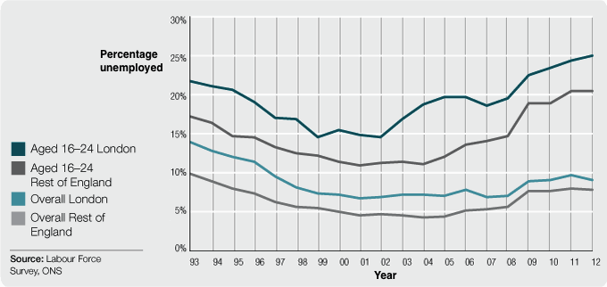
Question: The graph below shows the changes in young adult unemployment rates in England between 1993 and 2012.
[INTRO]: The given line graph illustrates (how) the percentages of young (English) adults who were out of work/unemployed in London and the rest of England (shifted) over a 20-year period starting from 1993.
[OVERVIEW] As can be seen from the chart, while the rates for young people aged/at the age of 16-24 experienced an upward trend, those for the young adult population declined slightly. Throughout the period, the highest unemployment rate was among the group of 16-24 in London.
Trend: The rates for [16-24] - upward trend & that for young adult population declined
Order: Highest unemployment rate – young adults [16-24] in London
Notes:
People aged … and young adults in general in … who were …

Slide 17
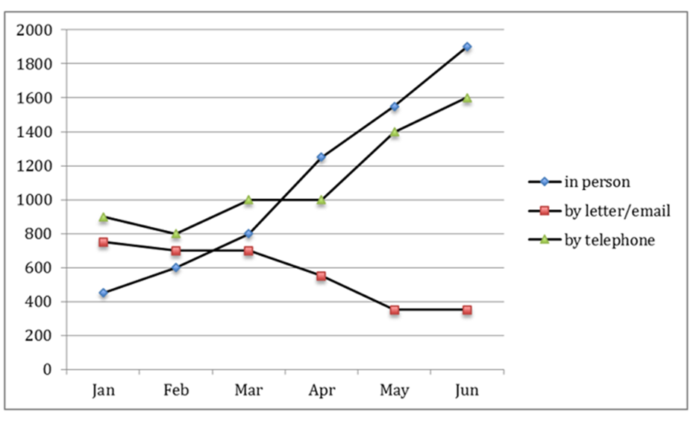
Question: The graph below shows the number of enquiries received by the Tourist Information Office
in one city over a six-month period in 2011
The chart compares the number of enquires made to /questions sent to a Tourist Information Office in one city by three channels, namely telephone, letter/email and in person, in 2011
Overall, the figures for / number of questions via telephone and direct communication rose substantially/soared, whereas there was a gradual decline in that via letter/email / mailing preference over the timescale.
Trend: the period witnessed a noticeable climb in the number of telephone calls and meetings, while that of letter/email fell.

